Slide 1


FARMS – A Framework For Web Apps
Enabling Automation–> Mitigating Complexity –> Ensuring Quality
Augmenting the reality!

Slide 2



WorkForce Software Application – WFS
Accuracy and Quality Delivered On Time
FARMS
Trends
Introduction
Enabling Automation–> Mitigating Complexity –> Ensuring Quality
A Hybrid Framework exclusively designed and developed to automate functional and regression suite for web based applications.
Portfolio comprises of the usage of Selenium Webdriver as a core engine and Java as a
primary language embedded with testing framework like TestNG along side
Extent Reports as test reporting tool, Jenkins as a CI tool, Maven as a build tool.
It has the ability to integrate with third party APIs. For instance, AutoIt, Sikuli etcs can
be directly associated with FARMS Framework
Easy to maintain and debug

Slide 3









Offerings
FARMS - Offerings
Enabling Automation–> Mitigating Complexity –> Ensuring Quality
FARMS
Usage of FARMS:
Autoit
Java
Testers – For Functional Testing
Testers – For Regression Testing
Maven
TestNG
Developers – For Unit Testing
BAs – For Acceptance Testing
Jenkins
Selenium Webdriver
Extent Reports
Connecting and empowering the whole system in a single esteemed Framework– FARMS
*FARMS – A complete technology package

Slide 4


FARMS - Process Flow
Enabling Automation–> Mitigating Complexity –> Ensuring Quality
Build Project
1
2
3
4
Test Script Development
TestNG Setup
Jenkins Execution
Report
Generation

Slide 5
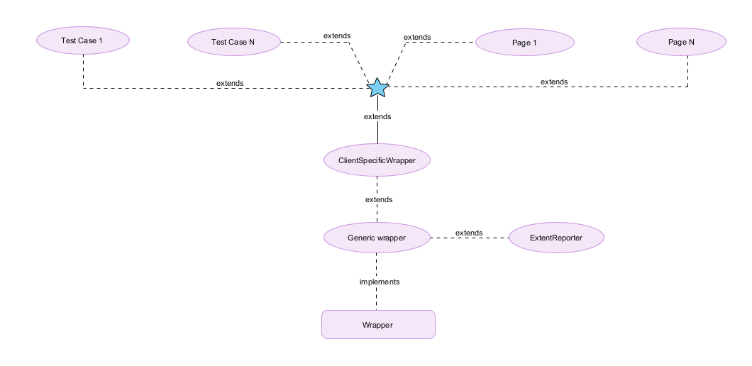
FARMS - Execution Flow
Enabling Automation–> Mitigating Complexity –> Ensuring Quality

Slide 6

FARMS - Return on Investment (ROI)
Enabling Automation–> Mitigating Complexity –> Ensuring Quality
Cost Saving
Deliver Quality Results
Decrease Manual Effort

Slide 7
WorkForce
Technology
Accuracy and Quality Delivered On Time
Oracle
Unix
FARMS
On Cloud
BO Server
Crystal Reports
Formula Language

Slide 8

WorkForce
Road Map
Accuracy and Quality Delivered On Time
WorkForce on Cloud
Upgrades for all the clients in pipeline
In urge of supporting new clients
Closed around ___ support tickets till date

Slide 9

WorkForce
Where Do We Stand
Accuracy and Quality Delivered On Time
5,00,000+
5,00,000+
Most Impressive and Profitable Product
One of the top most time reporting product across the globe
Continuous improvements and Stabilization in due course of time
Active Participants
Active Participants

Slide 10

WorkForce
Take a Tour
Accuracy and Quality Delivered On Time

Slide 11

Shared HR Apps
Enabling Strategic HR –> Mitigating Complexity –> Ensuring Compliance
Thank You

